Slide 1


Slide 2
GOOGLE STORE ANALYSIS AND PREDICTION
By: Abdulmajeed Abdulraheem
Data: Google store Analysis
Date: 02/20/2020

Slide 3
Material Outline:
Introduction
Objectives
Methodology
Conceptual Framework/Variables of Study
Descriptive Analysis
Research Question
Results/Findings
Conclusions
Recommendations
Appendix

Slide 4
Data Description
Android Apps data set was collected on July 2019. It has 10,814 observation and 13 feature
Features:

Slide 5
Objective:
To analyze and understand how android apps influence its users.
What the apps ratings and reviews system mean for users and proprietors
How do apps reviews and ratings system influence

Slide 6
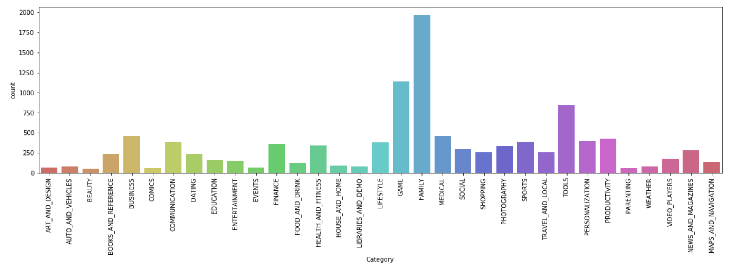
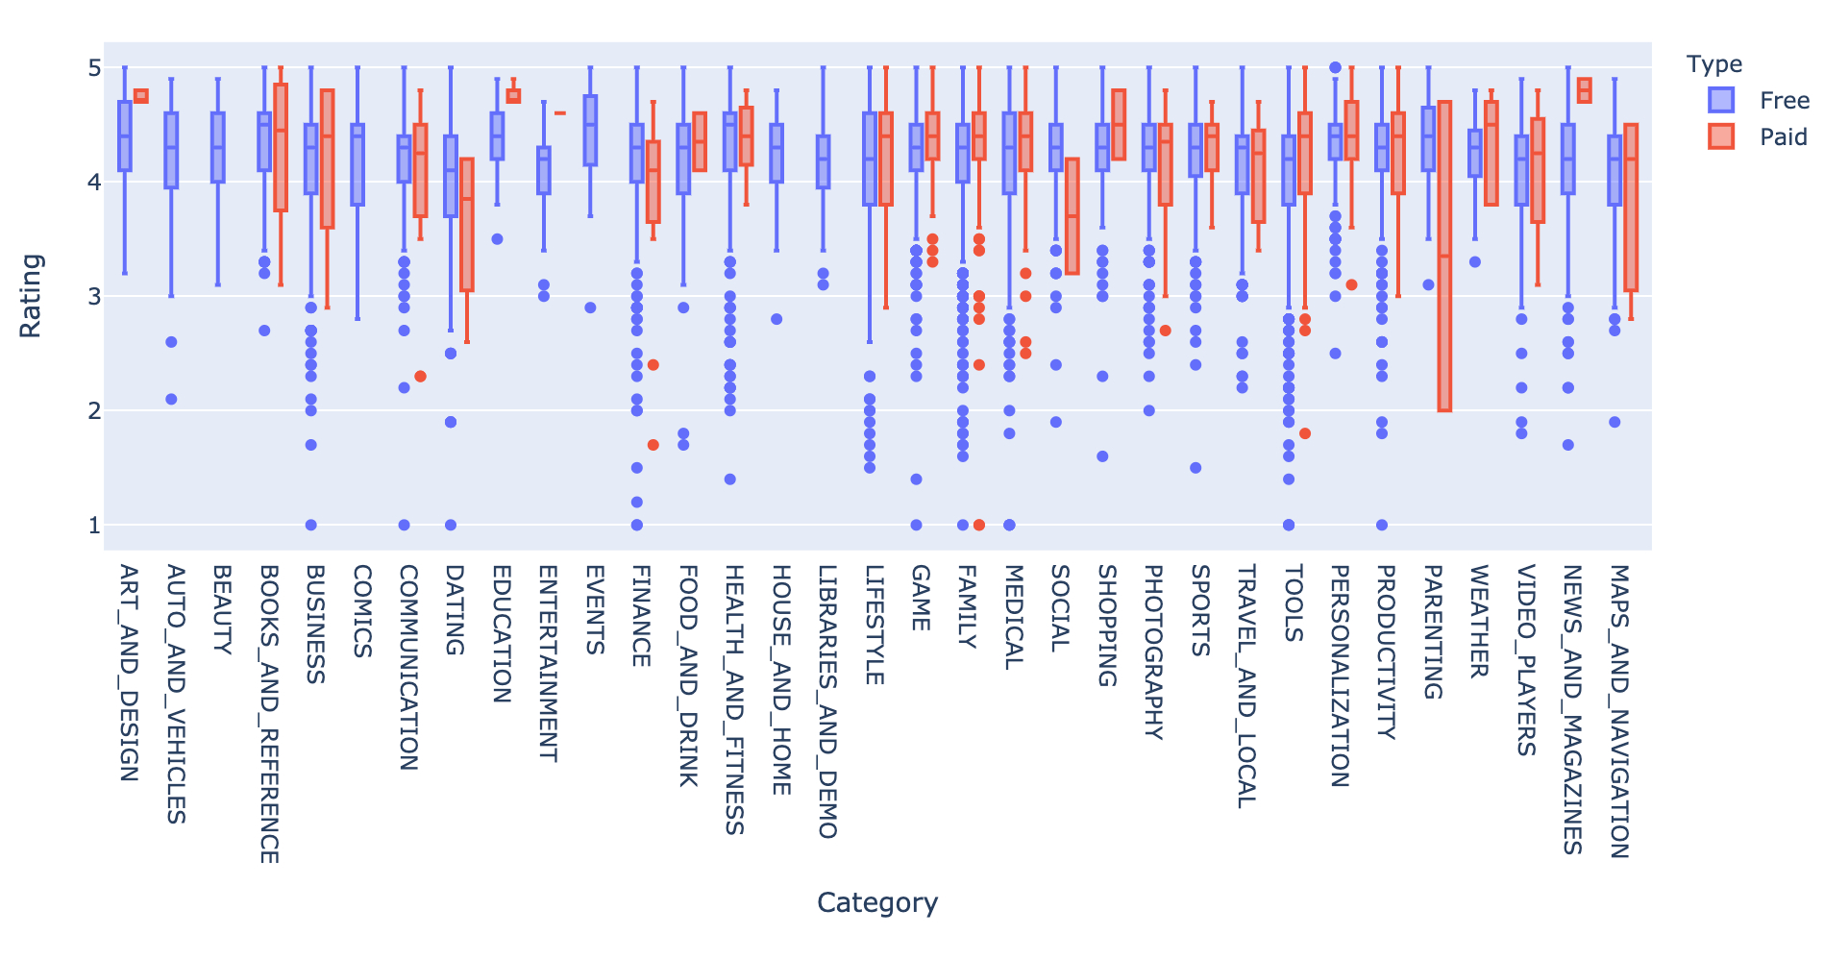
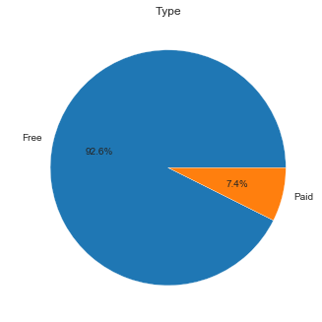
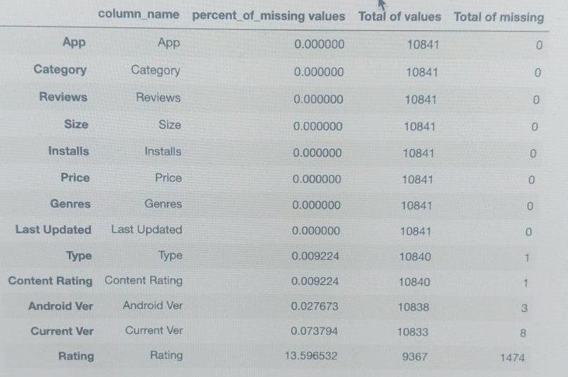
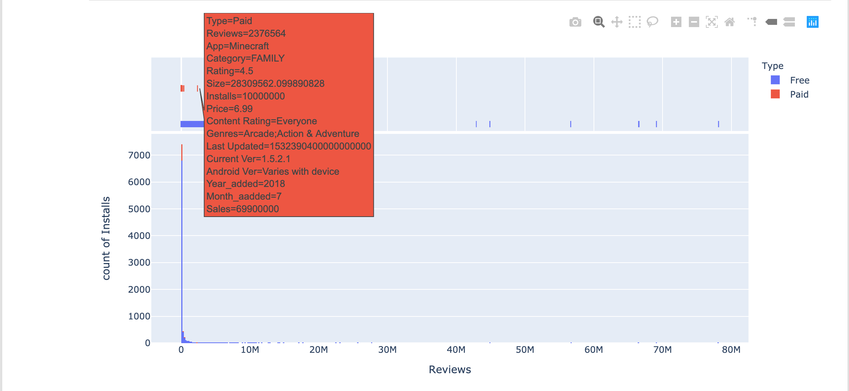

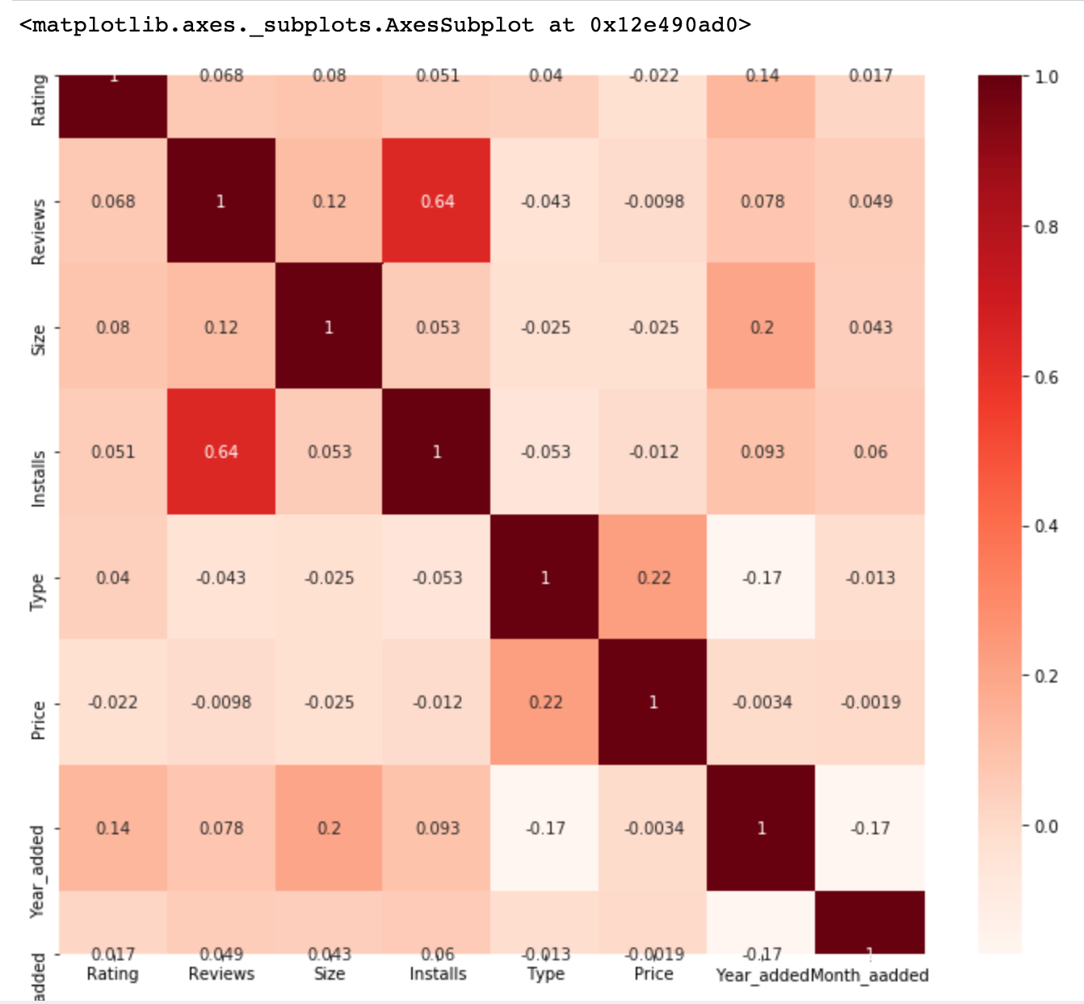
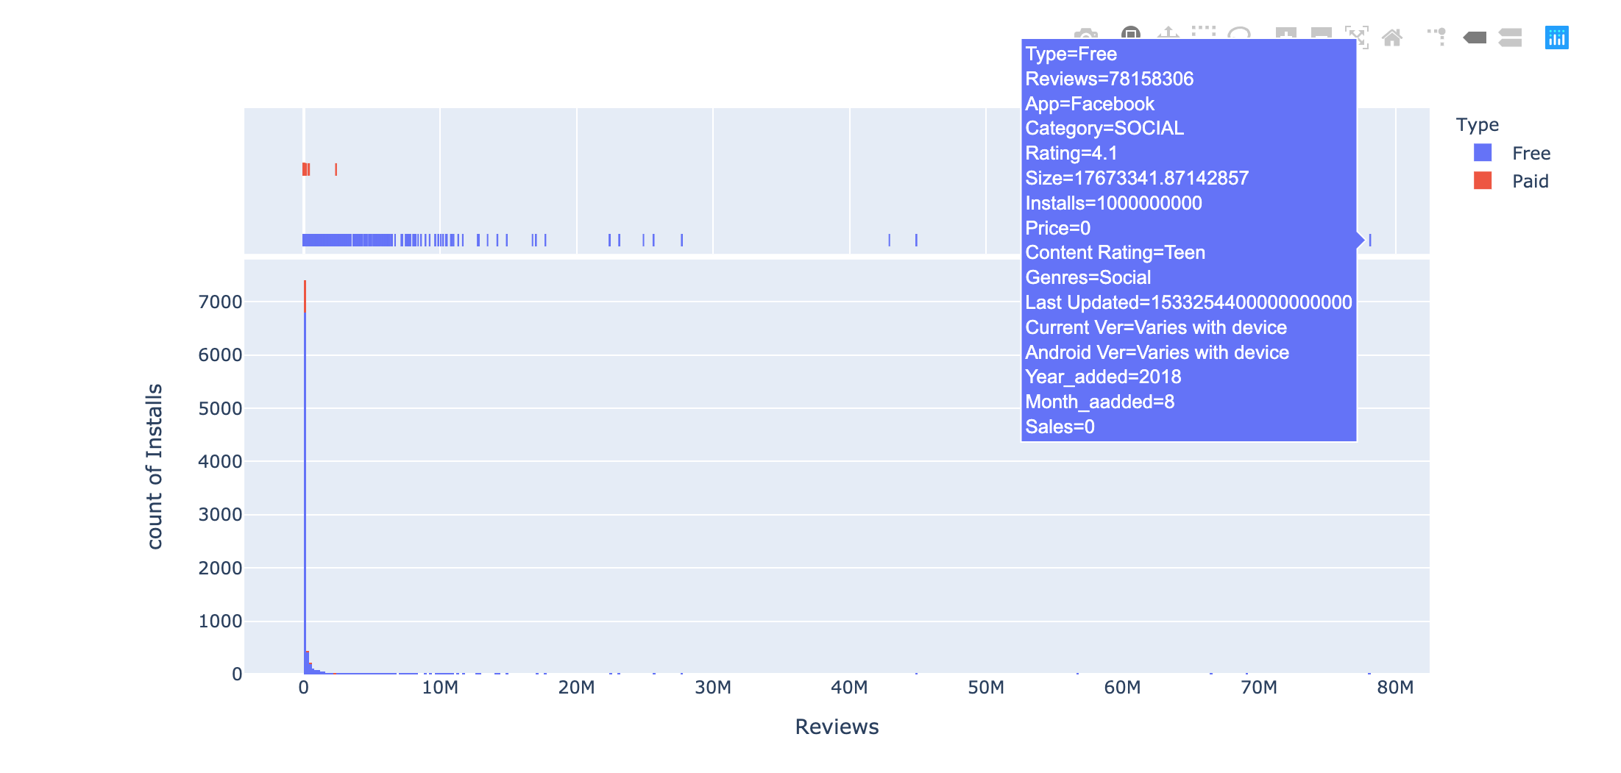
The Dataset has 10841 observations & 13 columns; App, Category, Reviews, Genres, Installs

Slide 7
What is the percentage of free application and paid applications on google store ?

Slide 8
Which category has the most applications on google store

Slide 9
Which app that has the most sales on google store ?
And on which category is that ?

Slide 10
What Category and which app has the most download from google store

Slide 11
Which group make profit on google store

